Slide 1
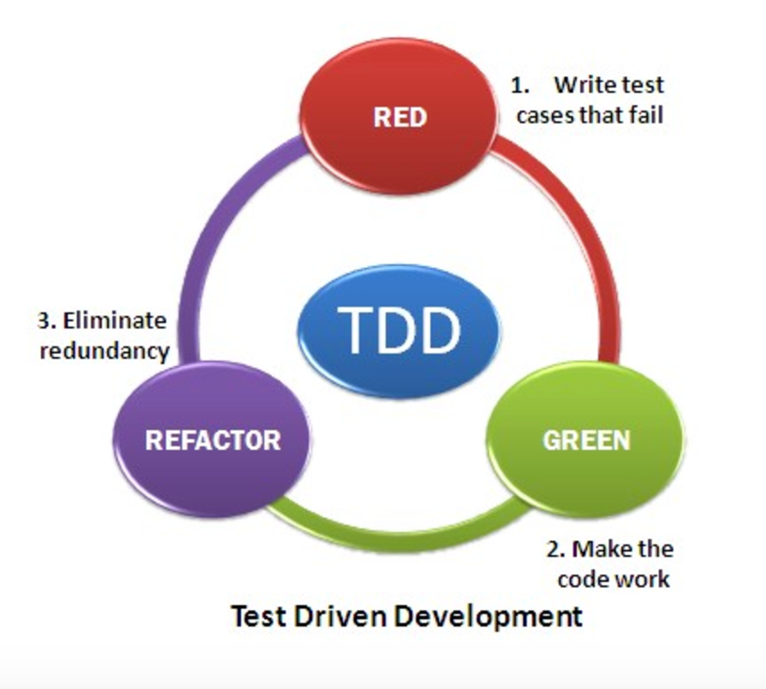

Test Driven Development (TDD)
Test-driven development (TDD) is an advanced
technique of using automated unit tests to
drive the design of software. Creating and
running automated tests inside.
It can be succinctly described by the following set of rules:
write a "single" unit test describing an aspect of the program
run the test, which should fail because the program lacks that feature
write "just enough" code, the simplest possible, to make the test pass
"refactor" the code until it conforms to the simplicity criteria
repeat, "accumulating" unit tests over time

Slide 2
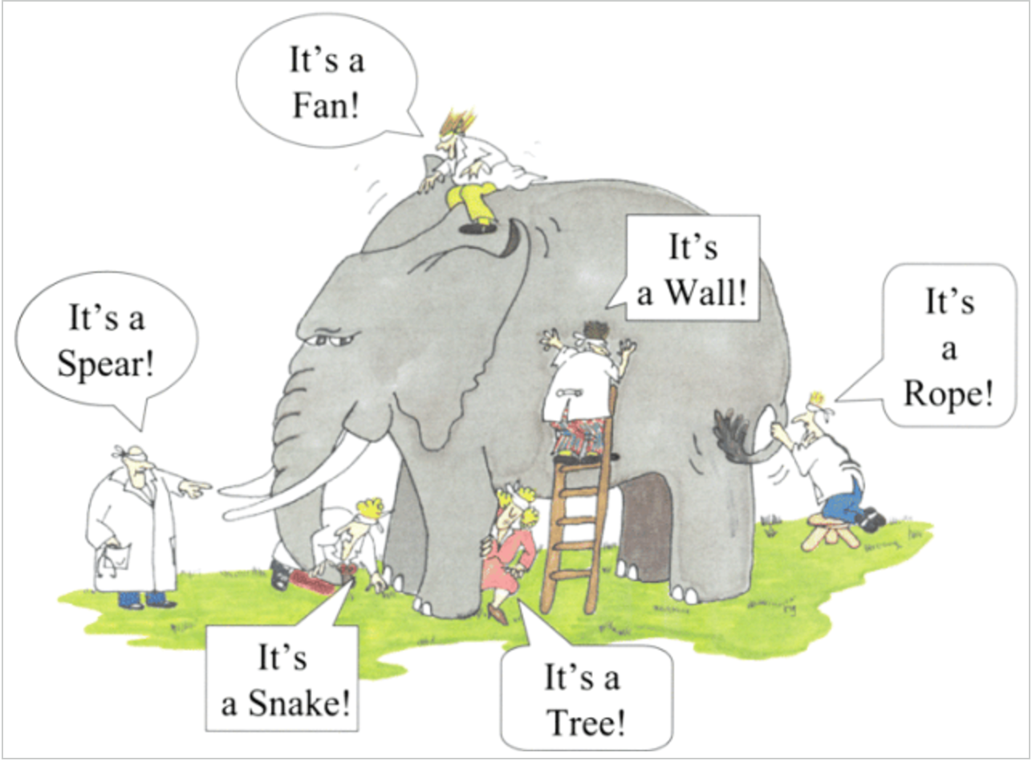
what is BDD?
BDD tries to solve the problem of “understanding requirements with examples”

Slide 3
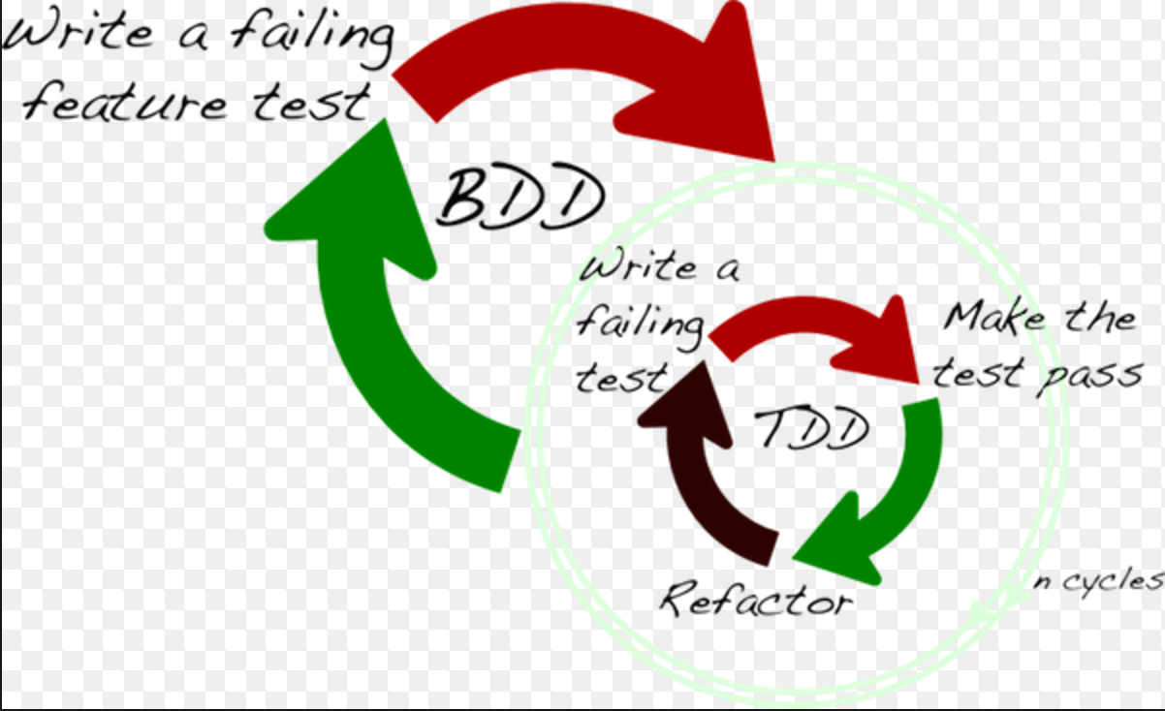
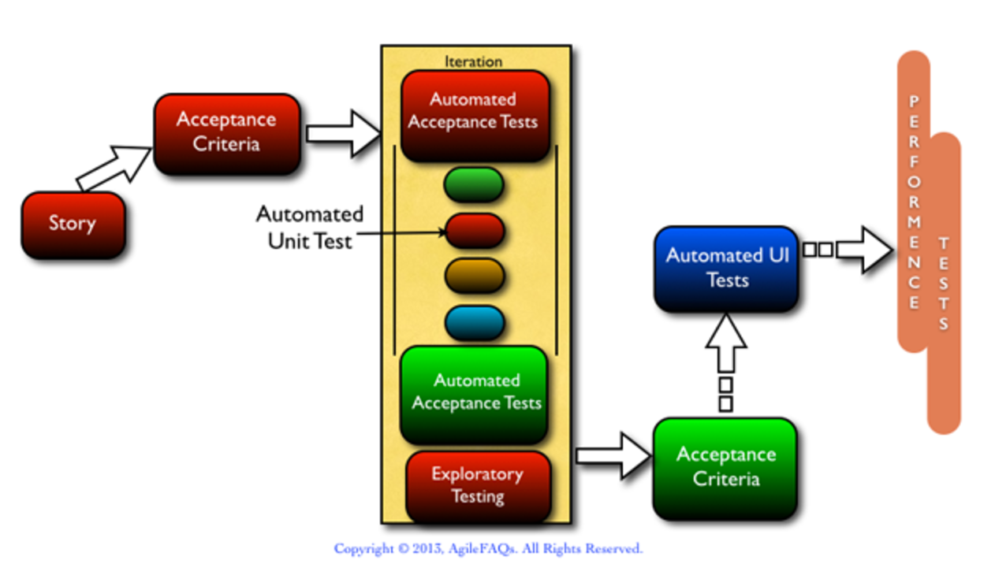
BDD (Behaviour Driven Development)
BDD is a subset of TDD.
Also Known as Specification by Example.
Dan North, who first formulated the BDD approach
Behaviour-driven development (BDD) is a software development methodology in which an application is specified and designed by describing how its behaviour should appear to an outside observer.

Slide 4
Agile BDD terminologies
User storey: Capture a description of a software feature from an end-user perspective. The user story describes the type of user, what they want and why. A user story helps to create a simplified description of a requirement.
"role-feature-reason": template is one of the most commonly recommended for teams and product owners starting to write user stories: As a, I want, So that
As a gmail user
I want to log in successfully
So that I can use all gmail functionalities/ I can send emails to others, Read my inbox emails, etc
"Given-When-Then": template intended to guide the writing of acceptance tests for a User Story:
(Given) some context - matches with pre-condition
(When) some action is carried out - matches with test steps
(Then) a particular set of observable consequences should obtain - matches with Expected Result
An example: Given I am a pre-registered gmail user,
When I enter valid username and password,
Then I should be successfully logged in and should able to see the welcome page
Acceptance criteria/tests: define the boundaries of a user story, and are used to confirm when a story is completed and working as intended.
Epic : Essentially a large user story that can be broken down into a number of smaller stories. It may take several sprints to complete an epic.
Feature: Functionality of the product like log in feature, Add to basket feature, etc
Scenario: Instead of referring to "tests", a BDD practitioner will prefer the terms "scenario" and "specification". In the form of Given-When-Then

Slide 5
Expected Benefits
BDD offers more precise guidance on organising the conversation between developers, testers and domain experts
Given-When-Then canvas, are closer to everyday language and have a shallower learning curve
Tools targeting a BDD approach generally afford the automatic generation of technical and end user documentation from BDD "specifications"/scenarios.
It produces the software that matters
Requirement becomes easy to understand and communicate
Provides detailed (executable) specifications.
Support evolutionary development
Provides concrete evidence that your code works.

Slide 6

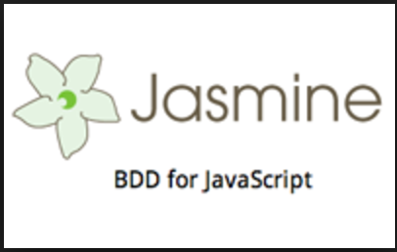
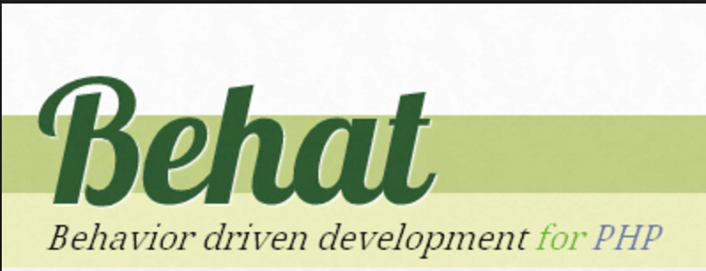
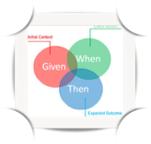



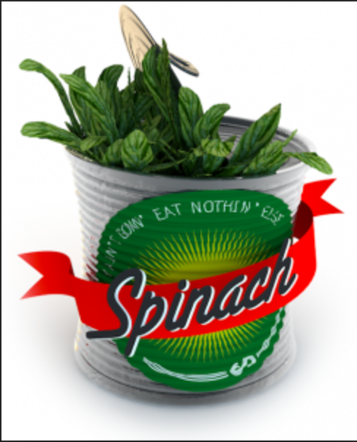
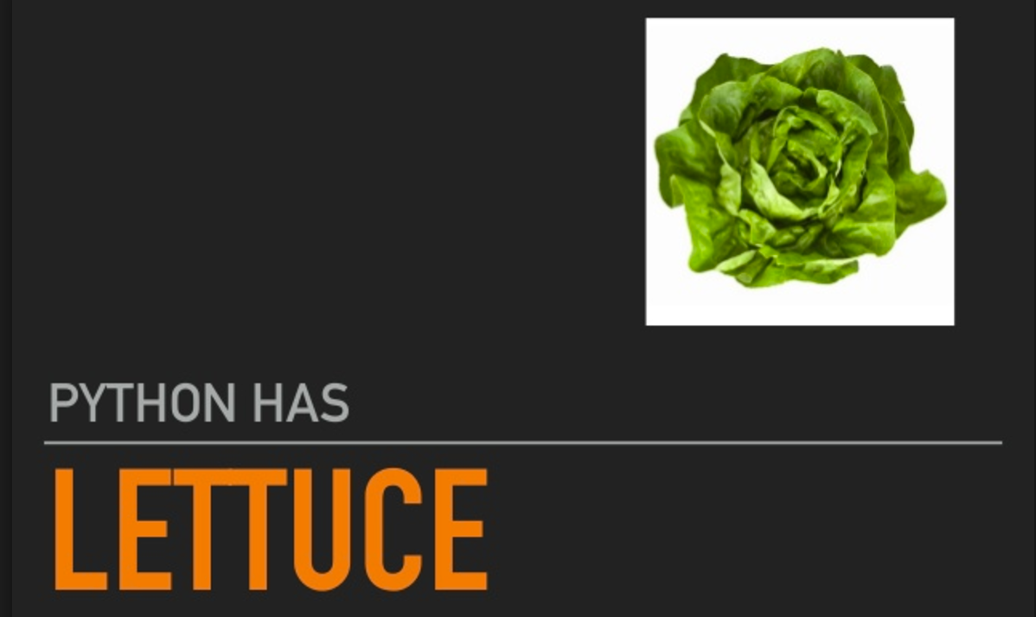
Bdd tools

Slide 7
what is gherkin?
Gherkin is the plain-text english language that Cucumber understands.
It is a Business Readable, Domain Specific Language that lets you describe software's behaviour without detailing how that behaviour is implemented.
Gherkin serves two purposes — documentation and automated tests.
Gherkin is designed to be easy to learn by non-programmers, yet structured enough to allow concise description of examples to illustrate business rules in most real-world domains.
In Gherkin, each line has to start with a Gherkin keyword, followed by any text you like. The main keywords are:
Feature
Scenario
Given, When, Then, And, But (Steps)
Background
Scenario Outline
Examples

